Slide 1
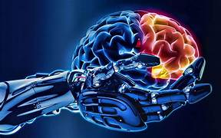
Introduction to Artificial Intelligence
Artificial Intelligence (AI) is a transformative technology that has the potential to revolutionize various aspects of our daily lives and industries. This document provides an overview of AI, its history, key concepts, and applications, as well as the ethical considerations surrounding its use. By understanding AI, we can better appreciate its capabilities and implications for the future.
Notes:
Artificial Intelligence (AI) means making computers and machines think and act like humans. It helps machines learn, solve problems, understand language, and even see and recognize things, just like people do.
In short
AI is about making machines smart so they can help us in daily life. It's used in many places – phones, cars, hospitals, schools, and more.

Slide 2
What is Artificial Intelligence?
Artificial Intelligence refers to the simulation of human intelligence processes by machines, particularly computer systems. These processes include learning (the acquisition of information and rules for using it), reasoning (using rules to reach approximate or definite conclusions), and self-correction. AI can be categorized into two main types: Narrow AI, which is designed to perform a narrow task (like facial recognition or internet searches), and General AI, which possesses the ability to perform any intellectual task that a human
Notes:
AI means giving machines the ability to learn, solve problems, and make decisions — like a human would.
Why Do We Use AI?
AI helps us:
Make life easier (like voice assistants: Siri, Alexa)
Do things faster (like finding info or sorting emails)
Make better decisions (like in healthcare, banking, or driving)

Slide 3

Hierarchy of Artificial Intelligence
General AI
AI capable of human-like intellectual tasks
1
Narrow AI
AI designed for specific tasks
2
Notes:
There are 3 Main Types
1. Artificial Narrow Intelligence (ANI) Also called: Weak AI ✅ What it does:
Can do one specific task really well Most of the AI we use today is ANI 💡 Examples: Siri or Alexa Google Maps Chatbots Face recognition on your phone
🧠 It does not think or understand—just follows rules.
2. Artificial General Intelligence (AGI) Also called: Strong AI 🔄 What it does:
Can think and learn like a human Understands, reasons, solves problems, and learns from experience Can do many tasks, not just one
💡 Examples: It's like a robot brain that’s as smart as a person
3. Artificial Super Intelligence (ASI)
🚀 What it does: Smarter than all humans Can do things humans can’t even imagine Might solve world problems or create new technology fast
💡 but we haven’t built this kind of AI 🧠 This would be a super genius machine

Slide 4





Key Milestones in the Evolution of Artificial Intelligence
1956
Dartmouth Conference coins "artificial intelligence
1980s
Rise of expert systems using rule- based logic
2010s-Present
Rapid advancements in deep learning
1960s-70s
Development of early AI programs like ELIZA
1997
IBM's Deep Blue defeats Garry Kasparov
Notes:
1950: Alan Turing introduces the Turing Test – Can machines think?
1956: Term "Artificial Intelligence" is born at a conference.
1980s: Expert systems used to solve problems using rules.
1997: IBM’s Deep Blue defeats chess champion Garry Kasparov.
2011: Siri (Apple’s voice assistant) is launched.
2020s: AI like ChatGPT, self-driving cars, and image generators become popular

Slide 5

Key Concepts in AI
Artificial Intelligence
The broad field of intelligent systems
Machine Learning
Learning from data without explicit programming
1
2
Deep Learning
Neural networks for complex data analysis
3
Natural Language Processing
Understanding and responding to human language
4
5
Computer Vision
Interpreting and acting on visual data
Notes:
Machine Learning 👉 AI that learns from data, like how we learn from experience. Example: Netflix learns what you like to watch.
Deep Learning 👉 A special kind of machine learning that uses layers of “thinking”, like a brain. Example: How Facebook recognizes faces in photos.
Natural Language Processing (NLP) 👉 Helps computers understand and talk in human language. Example: ChatGPT, Google Translate, voice assistants.
Computer Vision 👉 Lets computers see and understand pictures or videos. Example: Face ID on phones, self-driving cars.
Neural Networks 👉 A system that works like a tiny brain inside the computer. Used in deep learning to find patterns.
Robotics 👉 AI inside robots to help them move, sense, and act smart. Example: Robots that can vacuum your home.
Expert Systems 👉 Programs that follow rules like a human expert to make decisions. Example: A system that helps doctors diagnose diseases.
Reinforcement Learning 👉 AI that learns by trying, getting rewards when it does well. Example: A robot learning to walk or a computer playing a game.
Data 👉 The information AI learns from. The more data, the smarter it can get. Example: Photos, text, voice recordings, etc.
Algorithms 👉 Step-by-step instructions the computer follows to solve problems. Example: A recipe is an algorithm for cooking!

Slide 6












AI Applications Across Industries
Healthcare
AI algorithms aiding in disease diagnosis and treatment personalization.
Artificial Intelligence
Finance
AI used for fraud detection and algorithmic trading.
Transportation
AI enabling autonomous vehicles for navigation.
Customer Service
AI enhancing customer interactions through chatbots.
Notes:
AI is being applied across numerous sectors, including:
Healthcare: AI algorithms assist in diagnosing diseases, personalizing treatment plans, and predicting patient outcomes.
Finance: AI is used for fraud detection, algorithmic trading, and risk management.
Transportation: Autonomous vehicles rely on AI for navigation and decision-making.
Customer Service: Chatbots and virtual assistants enhance customer interactions and streamline support processes.

Slide 7









AI in Healthcare: Benefits and Challenges
Ethical considerations
Ethical considerations pose high challenges with limited benefits.
AI-powered diagnostics
AI-powered diagnostics offer high benefits but face significant challenges.
Personalized treatment plans
Personalized treatment plans offer high benefits with
manageable challenges.
Basic administrative tasks
Basic administrative tasks provide low benefits with minimal challenges.
Notes:
Healthcare: AI algorithms assist in diagnosing diseases, personalizing treatment plans, and predicting patient outcomes.

Slide 8






AI in Finance Cycle
Analyze Market Trends
AI algorithms analyze market data
Address Concerns
Concerns about bias and regulation
Assess Creditworthiness
AI assesses creditworthiness accurately
Execute Trades
AI executes trades at high speed
Notes:
Finance: AI is used for fraud detection, algorithmic trading, and risk management.

Slide 9
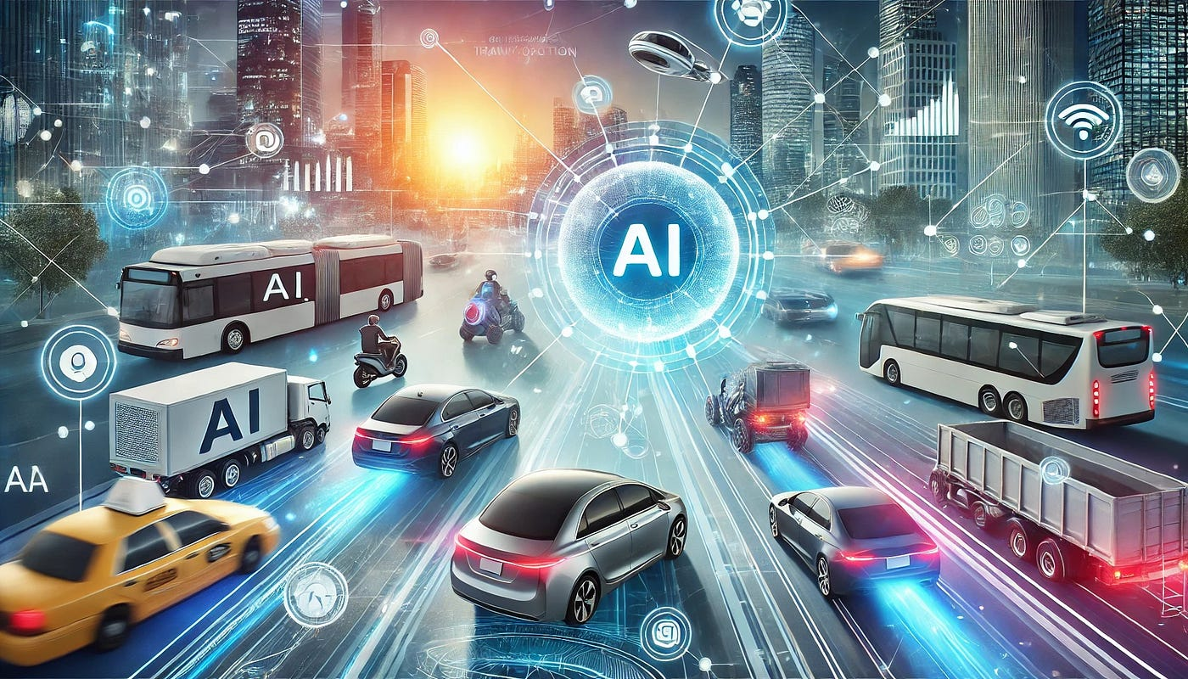
AI in Transportation
Notes:
AI is making transportation smarter, faster, and safer. Here's how:
✅ 1. Self-Driving Cars AI helps cars see the road, follow traffic rules, and avoid accidents.
Example: Tesla uses AI for its Autopilot feature.
✅ 2. Traffic Management AI analyzes traffic patterns and helps control traffic lights to reduce jams.
Used in smart cities to manage busy roads.
✅ 3. Ride-Sharing Apps Apps like Uber and Ola use AI to:
Match you with nearby drivers, Pick the fastest routes, Predict pricing (surge pricing)
✅ 4. Public Transport AI helps plan bus and train schedules based on real-time demand. Improves safety and efficiency.
✅ 5. Airline Industry AI is used for: Flight scheduling Predicting delays Customer service chatbots

Slide 10
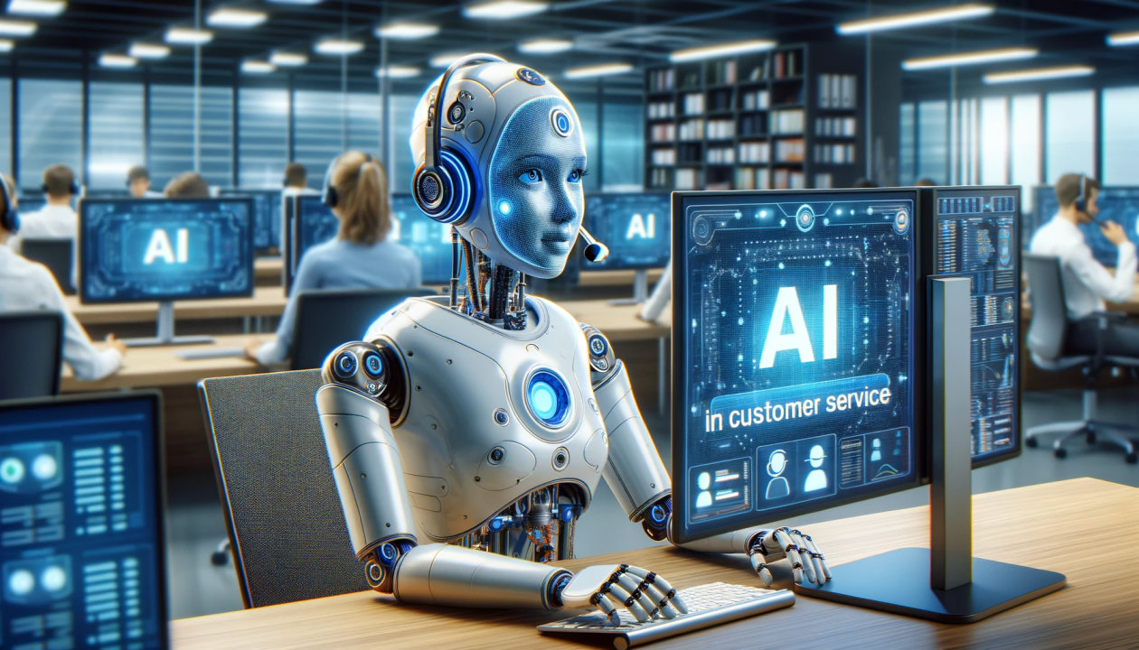
AI in Customer Service
Notes:
✅ 1. Chatbots
AI chatbots can answer questions anytime, without waiting for a human.
They help with things like order tracking, basic support, and booking appointments.
✅ 2. Virtual Assistants
AI assistants help customers by understanding what they say and giving helpful answers.
Example: Siri, Alexa, or customer support assistants on websites.
✅ 3. Personalization
AI learns what customers like and suggests products or services just for them.
Example: Online stores recommending items based on your shopping history.
✅ 4. Faster Problem Solving
AI analyzes customer issues quickly and directs them to the right department.
This saves time and improves customer experience.

Slide 11
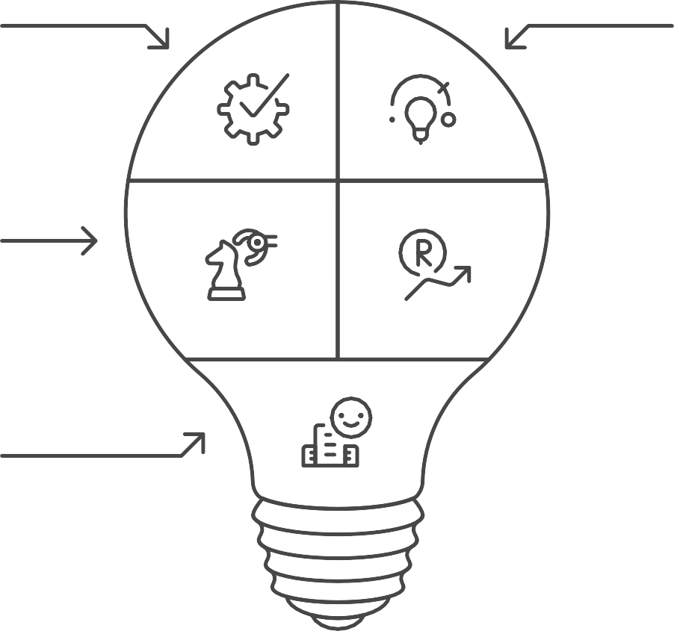

Opportunities of AI Adoption
Productivity Enhancement
Innovation Drive
Decision-Making Improvement
Revenue Stream Generation
Customer Experience Enhancement
Notes:
Using AI gives businesses and people a chance to work smarter, faster, and create new and better things! Like
Save Time - AI can do tasks quickly, so people don’t have to spend a lot of time on boring or repetitive work.
Better Decisions -AI looks at lots of information and helps people make smarter choices.
Personalized Experience - AI can understand what you like and offer things just for you, like music, movies, or shopping.
Reduce Errors - AI follows rules carefully and can avoid mistakes that humans might make.
Handle Large Data -AI can process and learn from huge amounts of data that humans can’t handle easily.
New Innovations - AI can help invent new products, improve healthcare, create self-driving cars, and much more.

Slide 12


AI Adoption
Pros
Cons
Competitive edge
High initial costs
Market responsiveness
Need for skilled workforce
Operational efficiency
Ethical concerns
Superior products
Industry leadership
Notes:
Pros (Good Things About AI)
Saves Time -AI works fast and can do tasks in seconds.
Works 24/7 -AI doesn’t sleep or take breaks — it's always available.
Reduces Errors -AI follows instructions and makes fewer mistakes than humans.
Handles Big Data -AI can quickly look at and understand large amounts of information.
Improves Customer Service -Chatbots and virtual assistants help customers anytime.
Cost-Effective-Over time, AI can save money by doing work without needing a salary.
❌ Cons (Challenges of AI)
Job Loss - AI can replace people in some jobs, especially repetitive ones.
High Initial Cost -Building and setting up AI systems can be expensive.
Lack of Human Touch -AI can’t feel emotions or understand people like humans do.
Needs a Lot of Data - AI needs lots of good data to work well.
Privacy Concerns -AI systems may use personal data, which can raise privacy issues.
If trained on unfair data, AI can make unfair decisions.

Slide 13











Technical Challenges in AI Adoption
AI Adoption Challenges
Data Quality Issues
Integration Complexities
Skill Gaps Underlying Factors
Notes:
AI is powerful, but setting it up and using it the right way can be technically hard, costly, and needs the right people and data.
Needs a Lot of Data - AI needs huge amounts of data to learn and work well. Without enough data, it doesn’t perform properly.
Data Quality - If the data is incorrect or messy, AI will make bad decisions.
Expensive Technology - AI systems often need powerful computers, special tools, and skilled people — all of which can be costly.
Lack of Skilled People - There are not enough experts (like AI engineers and data scientists) to build and maintain AI systems.
Hard to Understand (Black Box Problem) - Sometimes even the creators don’t know how AI made a decision — it’s like a mystery box.
Integration Issues - It can be difficult to connect AI with old or existing systems in a company.
Security Risks - AI systems can be hacked or misused, just like other technologies.

Slide 14




How to address AI challenges?
Navigate Regulations
Comply with evolving legal and ethical standards for AI
use.
Enhance Transparency
Improve understanding of AI decision-making processes to build trust.
Ensure Fairness
Address biases in AI systems to promote equity in decision-making.
Notes:
To solve AI challenges, we need good data, skilled people, clear rules, security, and human guidance. That way, AI can be used safely and wisely.
Use Good Quality Data
Train Skilled People
✅ 3. Use Strong Security
✅ 4. Follow Rules and Ethics
✅ 5. Make AI Transparent
✅ 6. Start Small, Then Grow
✅ 7. Keep Humans in the Loop
Use AI to help people, not fully replace them.
Let humans check and guide AI when needed.

Slide 15

Fundamentals of AI
Future Implications
Applications
Techniques Core Concepts
Notes:
AI is built on data, learning, language, and decision-making tools that help machines act smart — just like humans!
These are the basic building blocks of how AI works:
1. Data - 👉 AI learns from data, just like humans learn from experience. Example: AI looks at thousands of photos of cats to learn what a cat looks like.
2. Algorithms 👉 These are step-by-step instructions that tell the AI what to do. Example: A recipe is an algorithm for cooking.
3. Machine Learning 👉 A type of AI that learns from data and gets better over time. Example: YouTube learns what videos you like and suggests similar ones.
4. Neural Networks 👉 A system inside AI that works like a mini brain, helping it recognize patterns. Used in face recognition, voice assistants, etc.
5. Natural Language Processing (NLP) 👉 Helps AI understand and respond to human language. Example: Chatbots, Google Translate, Siri.
6. Computer Vision 👉 Lets AI see and understand images and videos. Example: Face ID on phones, self-driving cars seeing the road.
7. Decision Making 👉 AI uses what it has learned to make smart choices or predictions. Example: A self-driving car deciding when to stop or go.

Slide 16



Different Types of AI
Reactive AI
AI that reacts to current situations
Narrow AI
AI focused on specific tasks
General AI
AI with human-like intelligence
Notes:
Types of AI
Narrow AI – Does one job well (like Google Maps or Netflix suggestions)
General AI – Thinks and learns like a human (this doesn’t exist yet)
Super AI – Smarter than humans (still science fiction for now)
🧠 Common AI Technologies
Machine Learning – AI that learns from data
Natural Language Processing (NLP) – Helps machines understand human language
Computer Vision – Lets machines "see" images and video

Slide 17
1. Narrow AI (Weak AI)
1
Voice Assistants
AI that responds to voice commands.
2
Recommendation Systems
AI suggesting items based on preferences.
3
Image Recognition
AI identifying objects within images.
Notes:
Narrow AI refers to AI systems that are designed and trained to perform specific tasks. These systems operate under a limited set of constraints and cannot generalize their knowledge beyond their programmed functions. Examples include:
Voice Assistants: Such as Siri and Alexa, which can perform tasks like setting reminders or playing music.
Recommendation Systems: Used by platforms like Netflix and Amazon to suggest
content based on user preferences.
Image Recognition Software: Employed in applications like facial recognition and
medical imaging analysis.

Slide 18

General AI Capabilities
Complex Concept Understanding
Grasp of intricate ideas
Skill to find solutions to complex issues
Problem-solving
Ability to draw logical conclusions
Reasoning
The central concept of human-like intelligence
General AI
Notes:
General AI, also known as Strong AI, refers to a theoretical form of AI that possesses the ability to understand, learn, and apply intelligence across a wide range of tasks, similar to a human being. This type of AI would be capable of reasoning, problem-solving, and understanding complex concepts. As of now, General AI remains largely a concept and has not yet been realized.

Slide 19
AI Intelligence Hierarchy
Superintelligent AI
General AI Narrow AI
Notes:
Superintelligent AI is a hypothetical form of AI that surpasses human intelligence in all aspects, including creativity, problem-solving, and emotional understanding. This type of AI could potentially outperform the best human minds in every field, including scientific creativity and social skills. Discussions around Superintelligent AI often involve ethical considerations and the potential risks associated with its development.

Slide 20

Python Libraries for AI
This document provides an overview of essential Python libraries that are widely used in the field of Artificial Intelligence (AI). These libraries facilitate various tasks such as data manipulation, machine learning, and deep learning, making them invaluable tools for developers and researchers alike. Below, we will explore four key libraries: NumPy, Pandas, Scikit-Learn, and TensorFlow & PyTorch.
Notes:
Python libraries are —NumPy, Pandas, Scikit-Learn, and TensorFlow & PyTorch—are essential tools for anyone working in the field of Artificial Intelligence. They provide the necessary functionalities to manipulate data, build machine learning models, and develop deep learning applications, AI development.

Slide 21

Essential Python Libraries for AI
TensorFlow &
PyTorch
Frameworks for deep learning and neural networks
NumPy
Provides support for large, multi- dimensional arrays and matrices
Scikit-Learn
Features simple and efficient tools for data mining and data
analysis
Pandas
Offers data structures and tools for data analysis
Notes:
1. NumPy - 👉 Used for numbers and math. It helps AI do fast calculations with data. Think of it like a super calculator for Python.
2. Pandas 👉 Used for handling data (tables, files, etc.). Makes it easy to read, clean, and organize data.
3. Scikit-learn 👉 A powerful tool for machine learning. Used to build and train models like decision trees, classifiers, etc. Perfect for beginners and classic AI tasks.
5. TensorFlow 👉 Created by Google. Used for deep learning and neural networks (advanced AI). Great for big AI projects like image and voice recognition.
7. PyTorch 👉 Created by Facebook. Another powerful tool for deep learning and research. Popular with universities and researchers.

Slide 22
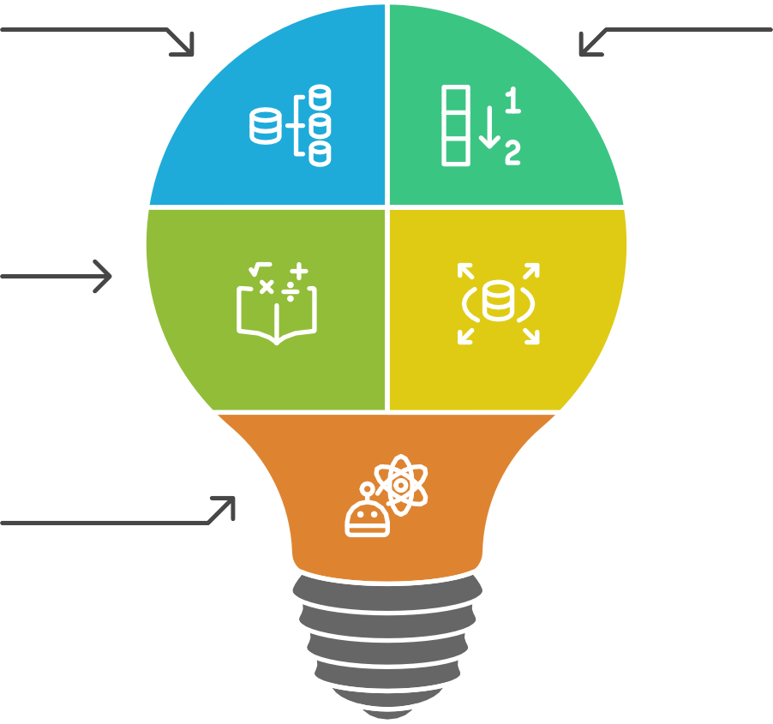
Components of NumPy
Arrays
Matrices
Mathematical Functions
Large Datasets
Scientific Computing
Notes:
NumPy, short for Numerical Python, is a fundamental library for numerical computing in Python. It provides support for arrays, matrices, and a plethora of mathematical functions to operate on these data structures. NumPy is particularly useful for handling large datasets and performing complex mathematical calculations efficiently. Its array-oriented computing capabilities make it a cornerstone for many scientific computing tasks in AI.

Slide 23
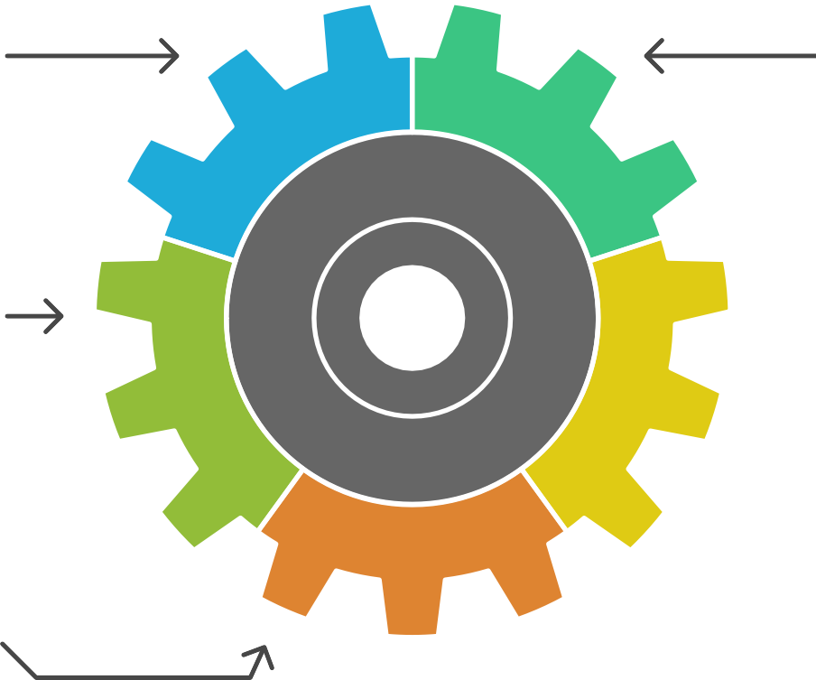




Pandas Library Overview
Data Structures
Data Cleaning
Data
Transformation
Data Visualization
Machine Learning
Preparation
Notes:
Pandas is a powerful data manipulation and analysis library that provides data structures like Series and DataFrames. It is designed for working with structured data and offers tools for data cleaning, transformation, and visualization. Pandas is particularly useful for preprocessing data before feeding it into machine learning models, making it an essential library for data scientists and AI practitioners.

Slide 24


Scikit-Learn Hierarchy
Extensive Documentation
Comprehensive guide for users
User-Friendly API
Easy integration and usage
Algorithms
Tools for machine learning tasks
NumPy & Pandas
Foundation for data manipulation
Notes:
Scikit-Learn is a robust machine learning library that provides simple and efficient tools for data mining and data analysis. It includes a wide range of algorithms for classification, regression, clustering, and dimensionality reduction. Scikit-Learn is built on top of NumPy and Pandas, making it easy to integrate with these libraries. Its user-friendly API and extensive documentation make it a popular choice for both beginners and experienced practitioners in the field of AI.

Slide 25




Compare TensorFlow and PyTorch for AI Development
Scalability and Production Readiness
Large-Scale Applications
Dynamic Computation Graph
Research Settings
TensorFlow
PyTorch
Notes:
TensorFlow and PyTorch are two of the most popular deep learning frameworks. TensorFlow, developed by Google, is known for its scalability and production readiness, making it suitable for large-scale machine learning applications. PyTorch, developed by Facebook, is favored for its dynamic computation graph and ease of use, particularly in research settings. Both libraries provide extensive support for building and training neural networks, enabling the development of sophisticated AI models.

